Slide 1
My First Day of Kindergarten
Picture of your child

Slide 2
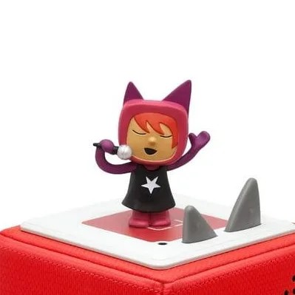
I get ready in the morning like usual. I use my Tonie playlist to help me do all my get ready tasks like getting dressed, brushing my teeth and hair, and doing my puffs. I like to sing along to the songs.

Slide 3
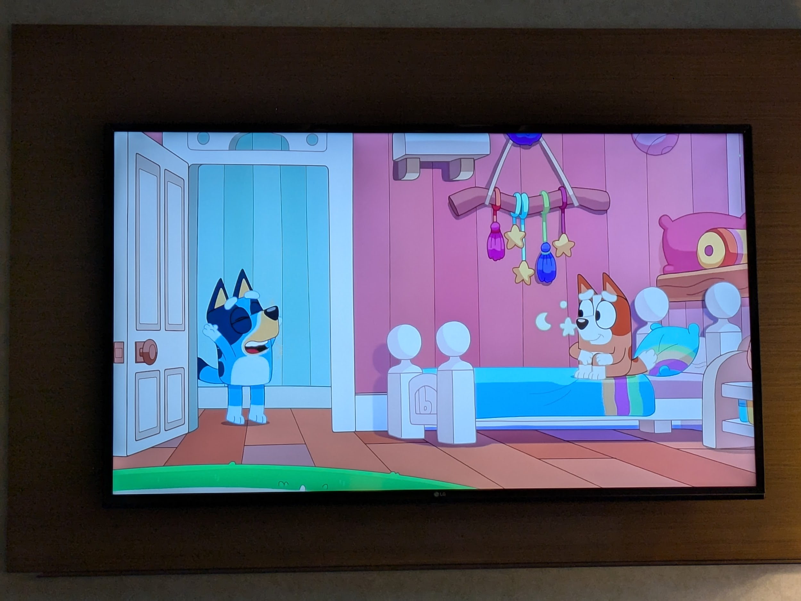
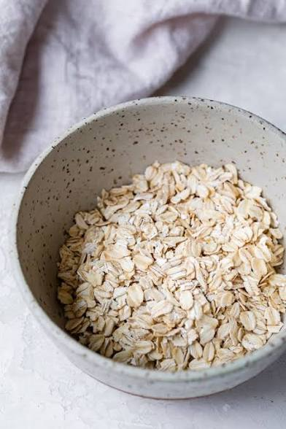
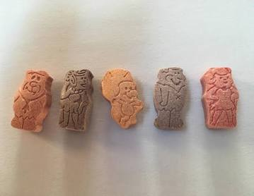
My mom gets me breakfast and my vitamins before she leaves for work. My mom always gives me a hug and kiss before she leaves. I watch TV until Dad is ready to leave.

Slide 4
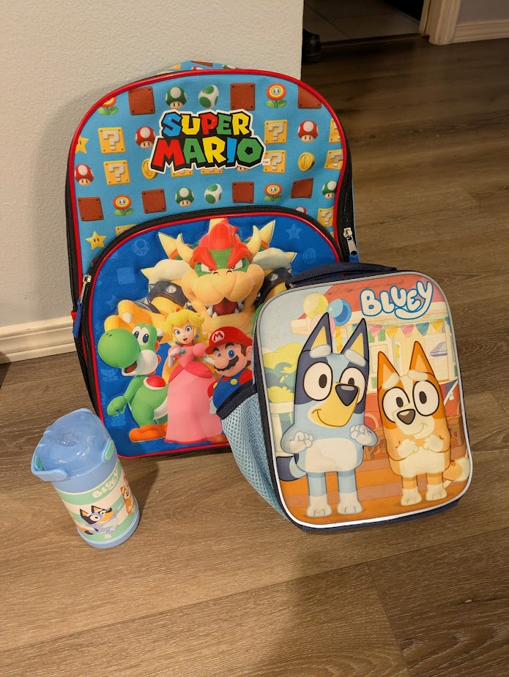
When we are ready to go, I get my lunchbox, water bottle, and backpack. There are many things I need everyday in my backpack like a change of clothes, my name tag, and a yellow folder. I grab my shoes and head to the car.

Slide 5
Picture of child and who will take them to school
Dad drives to school and we go to the gym for before school care. This feels a lot like what I did at daycare before I went to my pre-K class. I have extra snacks and can eat if I get hungry before school starts.
Picture of where they will go when they get to school

Slide 6
Picture of where your child will go to get to their class if they line up
The teacher at before school care will help me get to the right line for my kindergarten class. My teacher will meet us there and walk us to our classroom.
I might feel nervous getting to my class the first few times. This is ok. There are many adults from the school and older kids who will help me. If I'm feeling scared or lost, I should find a teacher or school staff to ask for help.

Slide 7
Picture of where your child should put their things
I made it to my classroom! My teacher shows us where to put our jackets and backpacks. I find the desk with my name on it.
Picture of your child’s desk

Slide 8
Picture of your child’s teacher (if available)
Picture of your child’s classroom
My teacher’s name is __________.
I sit at my desk while I wait for class to start. It is ok to talk to the other kids and get to know them until the teacher starts talking. [Teacher’s Name] put the day’s schedule on the board so I know what happens next.
My teacher gives clear instructions so I know what to do.
I’m learning so many interesting things on my first day!
Picture of class schedule
(If there is one. You may be able to request this as an accommodation if there isn’t one)

Slide 9
Pictures of kids doing activities at school
Pictures of kids doing activities at school
School starts at 8:45.
Some things I do may feel familiar to daycare like circle time, singing songs, and doing art projects
I may do some new things like completing worksheets and science experiments.
Pictures of kids doing activities at school

Slide 10
Pictures of kids playing at recess
My teacher, [Teacher’s Name], knows that it might be hard for me or classmates to sit still for a long time. They will schedule the day to make it fun and interesting.
I will also get breaks to wiggle, run, and play with my friends at recess. Like at daycare, I can play on the playground, play with some outside toys, and play outside games like tag or hide and seek. I can also choose to take a break and spend some time by myself. Recess is a time to recharge so I will choose an activity that feels good to my body.
A loud bell will ring when recess is over and it is time to go back to class.
Pictures of kids playing at recess
Pictures of kids playing at recess

Slide 11
Pictures of kids doing school activities in the classroom
After recess, I will go back to my classroom and my desk to learn more from my teacher. There are many things [Teacher’s Name] will help me learn like reading, writing, spelling, adding, subtracting, and how things work. Learning something new can be hard work but I will feel so good when I know how to do it.
It’s normal for me to feel frustrated sometimes when I am trying something new. I can ask my teacher for help or find a space to take a short break and try again.
Pictures of kids doing school activities in the classroom

Slide 12

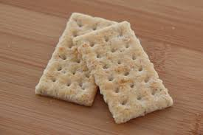

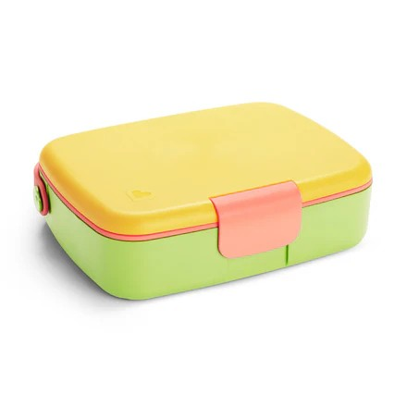
School will use up a lot of my energy! My school has scheduled a morning snack break and lunchtime so I can recharge my body.
At snacktime, I will get my snack from my backpack and eat at my desk with my classmates
At lunch, I can choose to eat my lunch from home or buy lunch from the school. If I buy lunch, my teacher will help me go to the cafeteria to get my food and come back to my desk to eat.

Slide 13
Pictures of kids playing at recess
Pictures of kids playing at recess
After lunch is more recess! This is my last recess. I can do the same things as morning recess or choose something different to do.
A loud bell will ring again to tell me it is time to go back to my classroom.
Pictures of kids playing at recess
Pictures of kids playing at recess

Slide 14
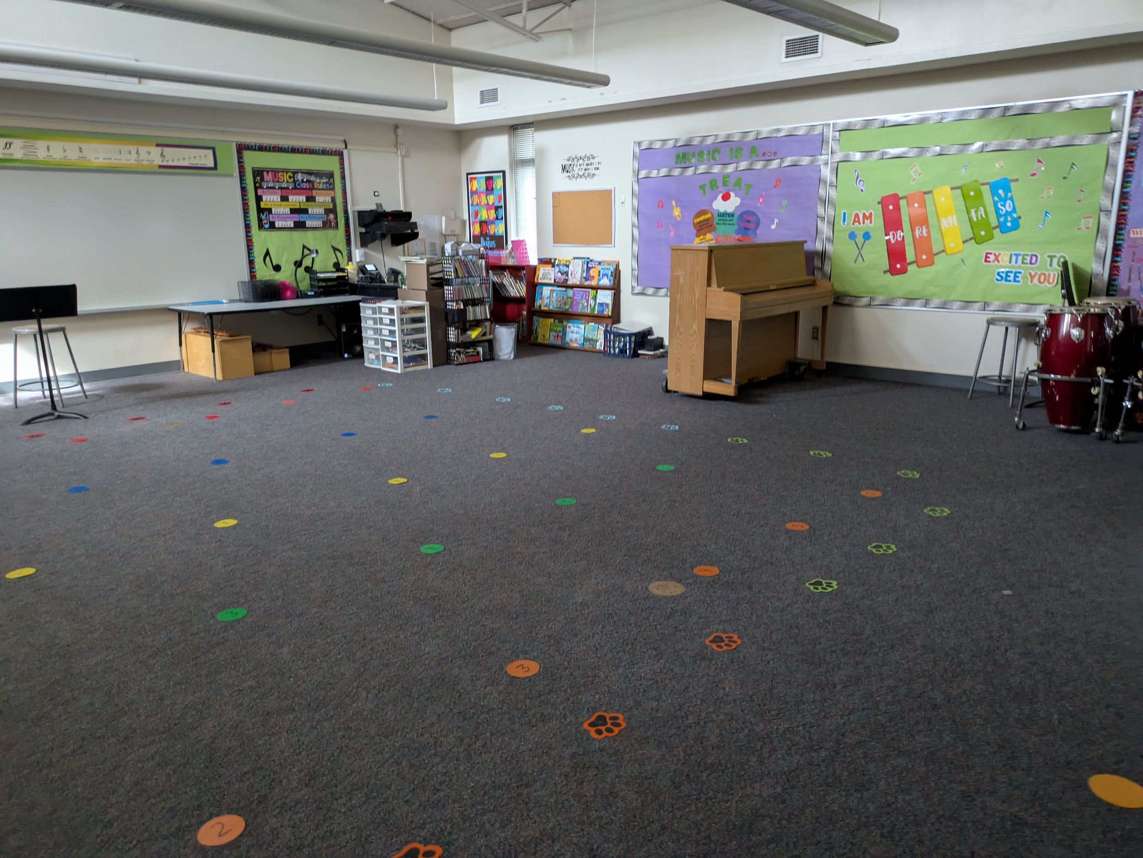
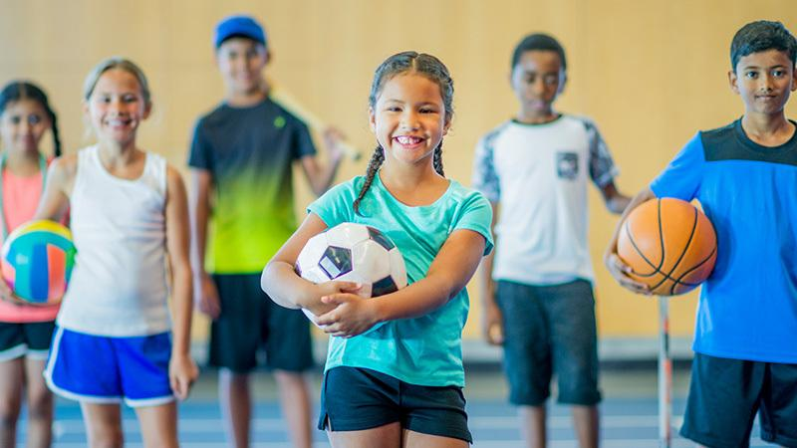
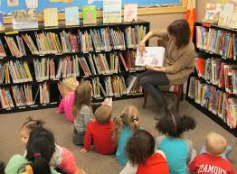
When I come back from recess, I will have more time in my class with my [Teacher’s Name]. Everyday I will also have a special class where I go to another room.
Two days each week, my special class is music class and PE. PE is a class where I will play exercise games and sports.
One day each week, I will have library time with my class where the librarian may read a story and I will have a chance to look for a book I may borrow.

Slide 15
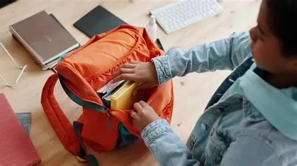
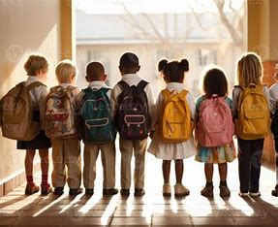
After my special class, I will go back to my classroom to finish the last activities [Teacher’s Name] has planned for the day.
A few minutes before school is over, my teacher will ask me to put my things in my backpack and get ready to leave.

Slide 16
Picture of pickup person
[Teacher’s Name] will help me go back to the gym for after school care. In the gym, I will have time to work on homework or play.
My mom will pick me up there like she does from daycare.
It’s normal to be hungry after school. I have an extra snack in my backpack if I am hungry. I can also get a snack when I get home.
Picture of pickup location

Slide 17
Fun, happy, excited picture of your child
I did it!
I am ready to learn and have fun in kindergarten!

